Slide 1
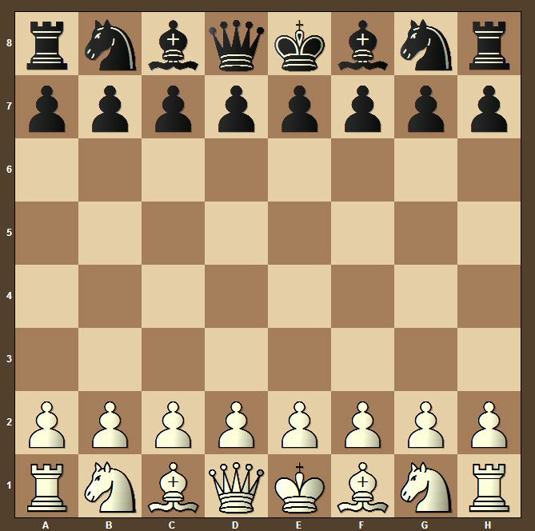
The Mathematics of Chessboard Puzzles

Slide 2

The Closed Knight’s Tour

Slide 3
The Knight’s Legal Moves
Notes:
Explain how the knight moves just in case the audience can’t recall.

Slide 4
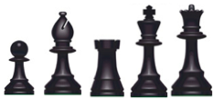
The Closed Knight’s Tour
Can the knight use legal moves to visit every square on the board exactly once and return to its starting position?
Why do we only pay attention to the knight?
Trivial Cases

Slide 5
The Open knight’s Tour

Slide 6
The Closed Knight’s Tour

Slide 7
How many closed knight’s tours are there on an 8 × 8 board?
How many open knight’s tours are there on an 8 × 8 board?
26,534,728,821,064
?

Slide 8
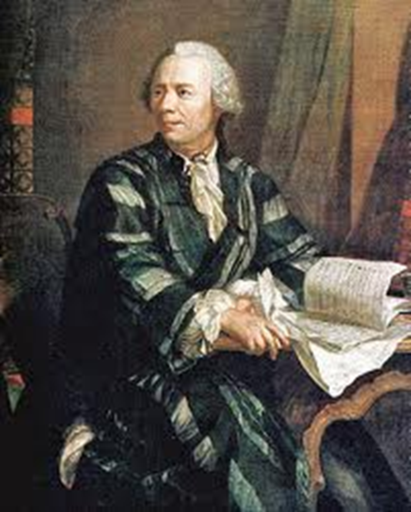
The closed knight’s tour has a long mathematical history.
Euler published tours for the 8 × 8 board in a 1759 paper.

Slide 9

Once a problem is solved, mathematicians want to generalize the problem as much as possible.
Thus, we do not restrict ourselves only to the standard 8 × 8 chessboard. Generalizations are quickly made to the square board, the rectangular board, three dimensional boards, etc.

Slide 10
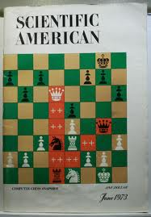
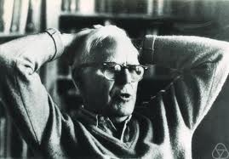
In his October, 1967 column in Scientific American, Martin Gardner discusses the knight’s tour on rectangular boards and other mathematical problems involving the knight.

Slide 11
The Rectangular Chessboard

Slide 12

Classifying The Boards
In 1991, Allen Schwenk completely determined which rectangular chessboards have a closed knight’s tour.
An m × n chessboard with m < n has a closed knight’s tour unless one or more of the following three conditions hold:
(a) m and n are both odd;
(b) m = 1, 2 or 4 ;
(c) m = 3 and n = 4, 6 or 8.

Slide 13
Condition (a): m and n are both odd.
Recall that a legal move for a knight whose initial position is a white square will always result in an ending position on a black square and vice-versa.
Hence, every tour representing the legal moves of a knight alternates between black and white squares.

Slide 14
Condition (a): m and n are both odd.
Suppose m and n are both odd.
There will exist an odd number of squares on the board.
The number of black squares will not equal the number of white squares.
No closed tour can exist.

Slide 15
Condition (b): m = 1, 2 or 4.
Suppose m = 1
Suppose m = 2

Slide 16
Condition (b): m = 1, 2 or 4.
For 4 × n boards we require a more complex coloring of the board than the traditional black and white coloring.

Slide 17

Condition (b): m = 1, 2 or 4.
Note that a knight must move from a brown square to a black square. Likewise, a knight must move from a white square to a green square. Two closed cycles are now forced to exist and no closed tour exists for the 4×n board.
Solomon Golomb

Slide 18
Condition (c): m = 3 and n = 4, 6, or 8.
For the 3×4 board consider the squares 1, 3 and 11. These squares have only two possible moves.
The cases for the 3×6 and 3×8 boards are shockingly similar.
1 | 4 | 7 | 10
2 | 5 | 8 | 11
3 | 6 | 9 | 12

Slide 19
The Existence of a Closed Tour
1 | 4 | 7 | 26 | 13 | 28 | 11 | 22 | 19 | 16
6 | 25 | 2 | 29 | 8 | 23 | 14 | 17 | 10 | 21
3 | 30 | 5 | 24 | 27 | 12 | 9 | 20 | 15 | 18
A | D | G | J
L | I | B | E
C | F | K | H

